Slide 1
CARDIOVASULAR DISEASE DETECTION
TEAM ID- 20
COLLEGE NAME- BHAI PARMANAND DSEU SHAKARPUR CAMPUS 2
TEAM LEADER- YASH KUMAR VERMA
MEMBERS- RAKSHIT KUMAR SINGH

Slide 2
AGENDA
The Main Objective of Developing this project is: Predict whether a patient should be diagnosed with Heart Disease. This is a binary outcome.
Positive (+) = 1, patient not diagnosed with Heart Disease.
Negative (-) = 0, patient diagnosed with Heart Disease.
Experiment with various Classification Models & see which yields greatest accuracy.
Examine trends & correlations within our data.
Determine which features are most important to Positive/Negative Heart Disease diagnosis:
1.To Implement machine learning model to predict future possibility of heart disease by various machine learning algorithms.
2.To determine significant risk factors based on dataset which may lead to heart diseases.
3.To analyse feature selection methods and understand their working principle.

Slide 3
PROBLEM STATEMENT
Given the clinical parameters about the patients, can we predict whether or not they have Cardiovascular disease.

Slide 4
PROJECT OVERVIEW
The main purpose of designing this system is to predict the risk of heart disease in a patient and trying to achieve maximum accuracy. We have used Various Machine Learning algorithms to evaluate and train the model, such as Logistic Regression, Decision Tree Classifier, Random Forest Classifier, K-nearest neighbor, Naive Bayes method and Support Vector Machine (SVM). The main objective of this project is not just predicting the risk of a heart attack but also analyzing and putting some results which might help us to determine the risk factors based on the patient’s vital signs and to extract some insights which helps us to understand their working principle.

Slide 5
THE WOW FACTOR IN OUR SOLUTION
The only wow factor is that we have compared six machine learning models and we have found model that could give the best possible result.

Slide 6
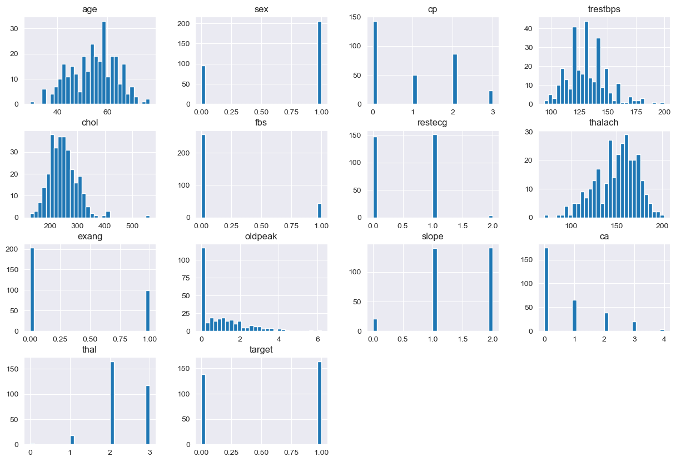
Corelations of features

Slide 7
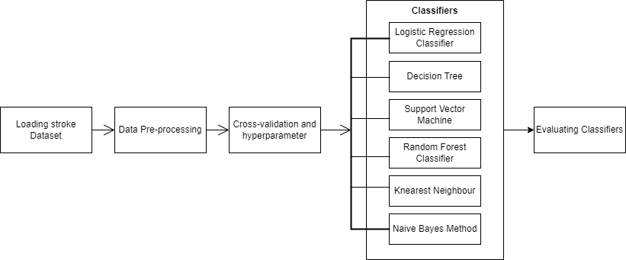
MODELLING

Slide 8
RESULTS
We have used 6 algorithms findings about which are shown bellow in the form of Heatmap and confusion matrix. After that comparison of accuracies in the form of bar graph.

Slide 9
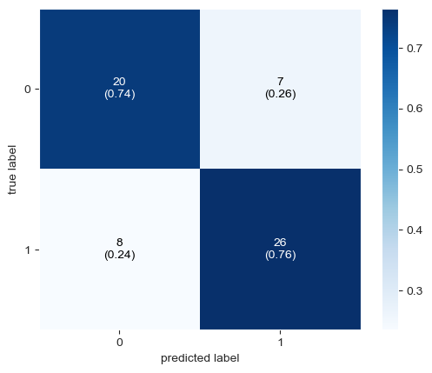
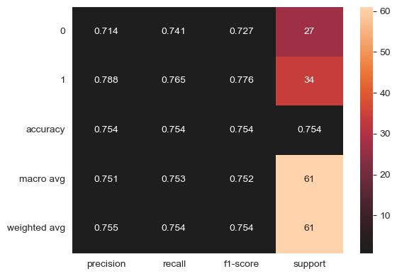
DTclassifier Results

Slide 10
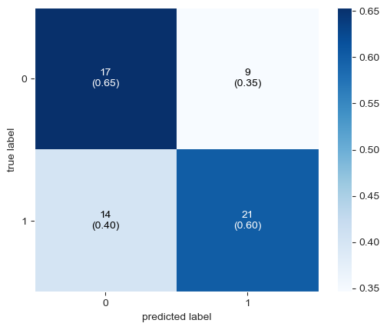
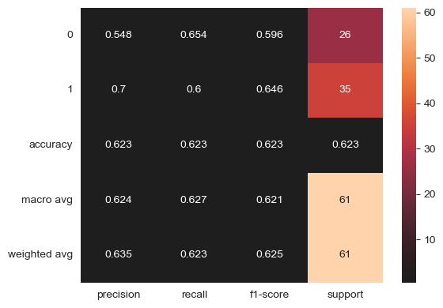
K-nearest neighbour Results

Slide 11
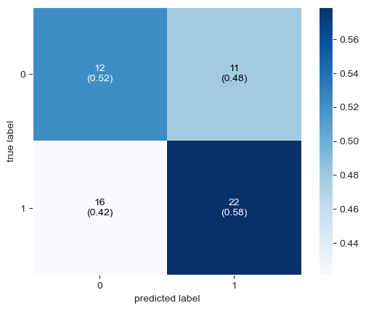
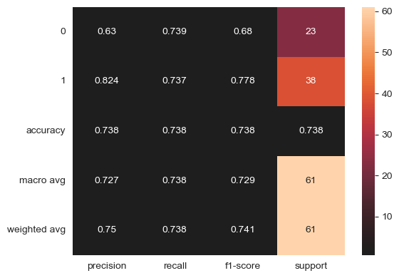
Naïve Bayes Results

Slide 12
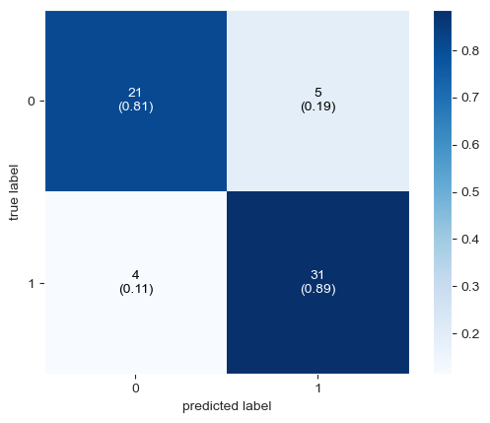
Logistic Regression Results

Slide 13
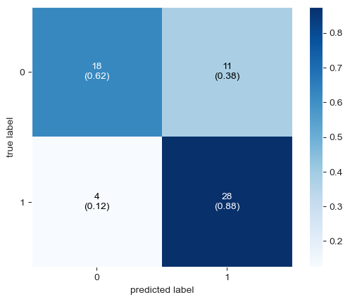
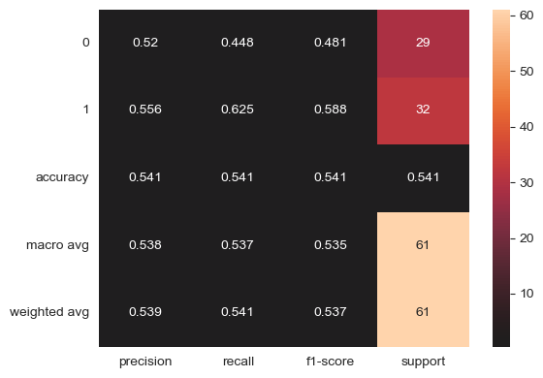
Support Vector Machine Results

Slide 14
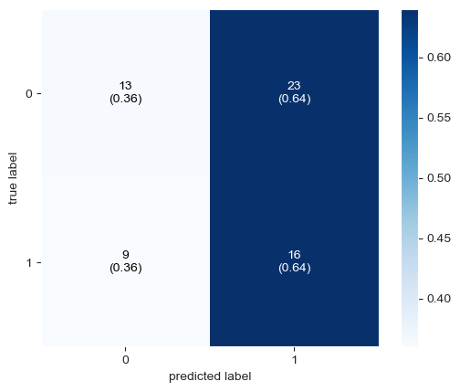
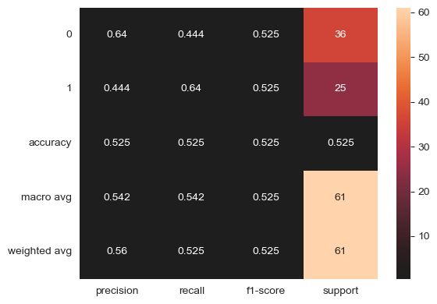
Random Forest Classifier Results

Slide 15
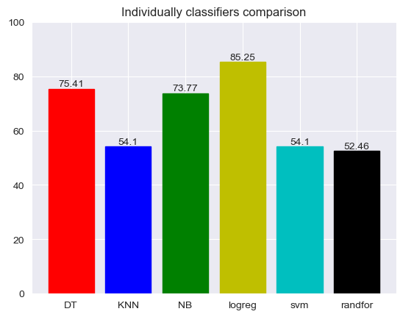
Accuracy Score Comparission

Slide 16
CONCLUSION
The best machine learning model according to research his logistic regression. The model accuracy is 85.25%.

Slide 17
Thank you…

